Slide 1
Image Enhancement
Concepts, Tools, and Applications
Computer Vision, 6th Semester, 2024

Slide 2
Image Enhancement
Processing an image to enhance/improve certain features/aspects
Result becomes more suitable/desirable than the original image for specific application
Processing techniques are highly application dependent

Slide 3
Image Enhancement methodologies
Spatial enhancement
Work on image plane itself
Direct manipulation of the image pixels
Frequency-domain enhancement
Transform the image to different domain (spatial -> frequency)
Perform enhancement in the new domain
Transform back

Slide 4
Spatial Enhancement
Mathematically,
g (x, y) = Enhanced image
f (x, y) = Original image
T = Transformation function defined over the neighbourhood of a pixel
Again such techniques can be broadly categorized into following types
Point Processing Techniques
Histogram Based Techniques
Mask Processing Techniques

Slide 5
Image Processing techniques
Point processing:
g(x, y) depends only on f(x, y)
Mask/neighbourhood processing:
g(x, y) depends on f(x, y) and f(Neighbourhood(x, y))
Global processing:
g(x, y) depends on entire image

Slide 6
Point Processing
Brightness and Contrast change:
g(x, y) = c*f(x, y) + b
c = contrast factor (usually a decimal number)
b = brightness factor (usually an integer)
Limits: 0 (black), Max (white)
Transfer function manipulation

Slide 7
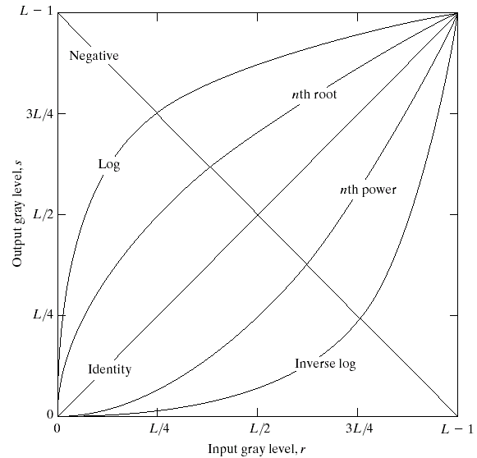
Transfer function manipulation
Linear Functions
Identity transformation
Negative transformation
Logarithm function
Log transformation
Inverse-log transformation
Power-law function
n-th power transformation
n-th root transformation

Slide 8
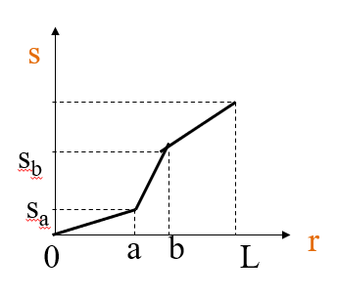
Transfer function manipulation
Contrast stretching

Slide 9
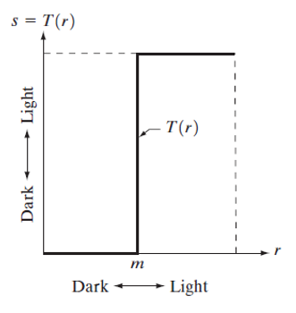
Transfer function manipulation
Thresholding:
Set all pixels above a value T as white and below as black (binary thresholding).
Or, use multiple threshold values for multiple region formation (multi-thresholding).

Slide 10
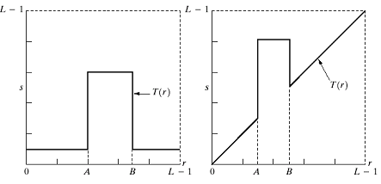
Transfer function manipulation
Gray-level slicing:
Set pixels within a range (a, b) as white to remove/preserve the remaining (background) pixels.
First figure shows background removal.
Second figure shows background preservation.

Slide 11
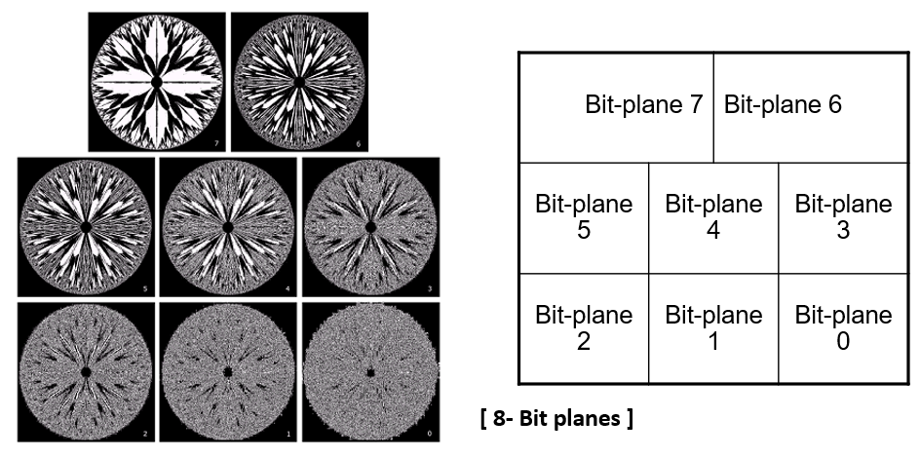
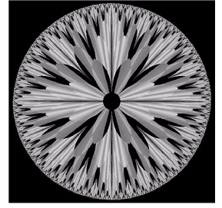
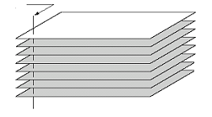
Bit-plane Slicing
Form bit planes from each bit of a pixel value.
Manipulate each bit-plane individually instead of accessing whole pixel values.
Least-significant bit (LSB, rightmost bit) gives no visible difference when changed.
Most-significant bit (MSB, leftmost bit) shows drastic difference when changed.
Bit-plane 7 (most significant)
Bit-plane 0 (least significant)

Slide 12
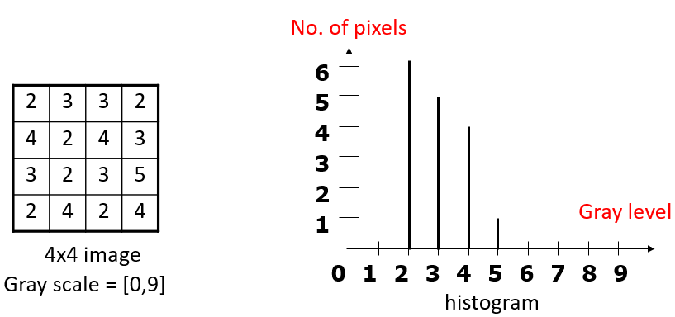
Histograms
Graphical representations of the number of occurrences of pixel intensities
Histogram of a digital image with gray levels in the range [0, L-1] is a discrete function
h(r_k) = n_k
Where
r_k : the kth gray level
n_k : the number of pixels in the image having gray level r_k
h(r_k) : histogram of a digital image with gray levels r_k

Slide 13
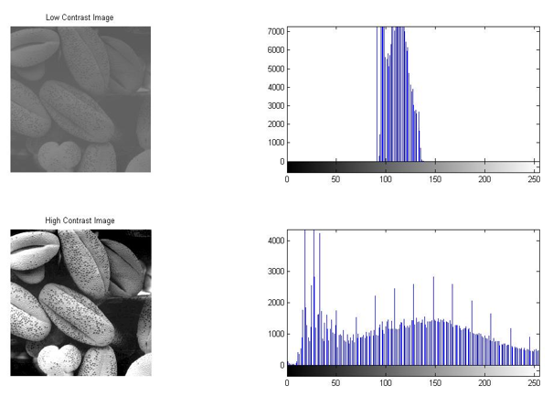
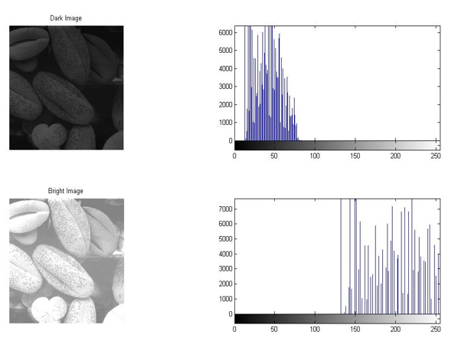
Histogram types
Contrast difference
Brightness difference

Slide 14
Histogram processing
Histogram Equalization
Concept: find a mapping f(h) from original histogram such that the histogram of the modified (equalized) image is flat (uniform)
Repeated equalization produces no significant effect after first equalization
No reference histogram required
Histogram Specification/Matching
Flatten/tighten the original histogram to conform/match with a given histogram
Specified/Desired/Reference histogram is necessary

Slide 15
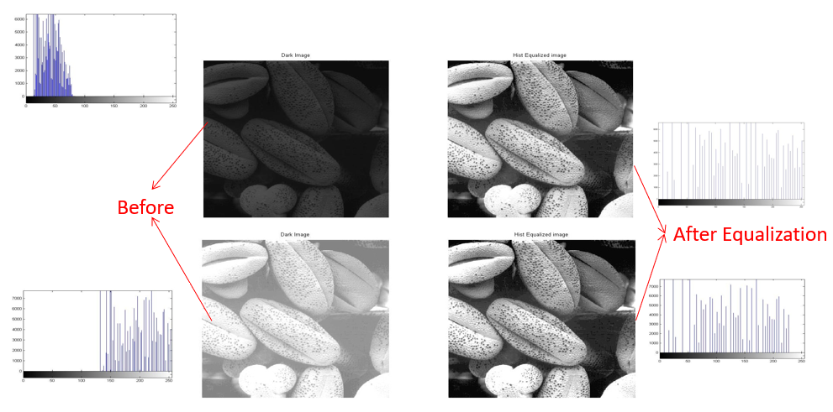
Histogram Equalization

Slide 16
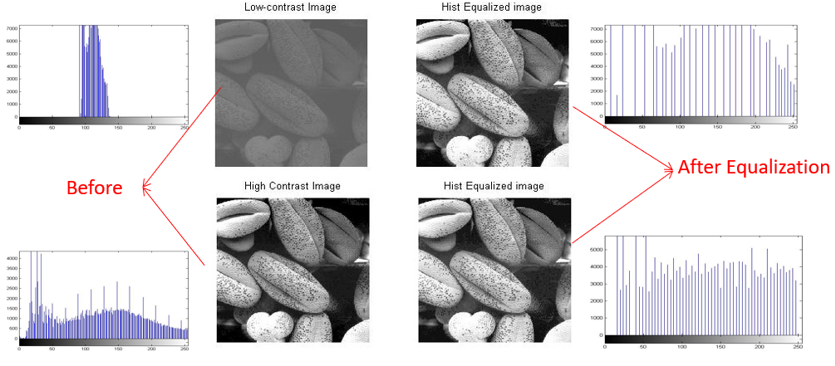
Histogram Equalization

Slide 17
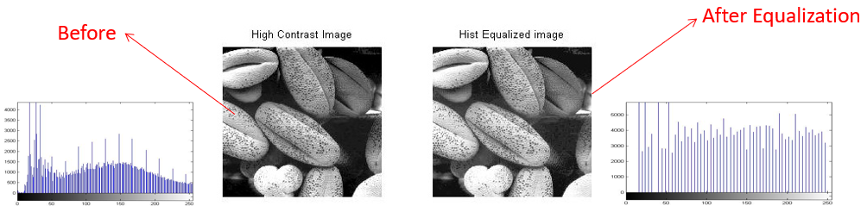
Histogram Equalization

Slide 18
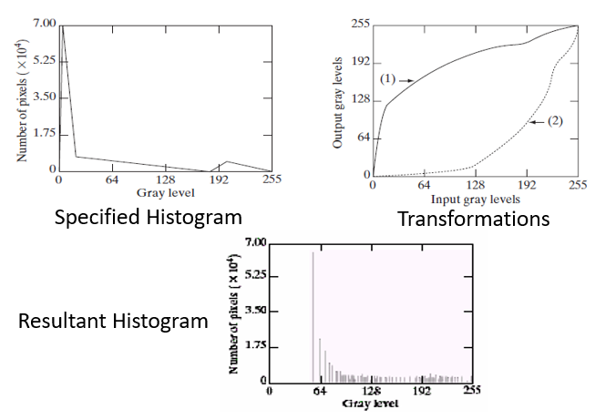
Histogram Specification

Slide 19
Mask Processing
Also called ‘filtering’
Discussed in Image Filtering

Slide 20
Other Techniques
Morphological operations
Color correction
Edge highlighting
Image blending

